Slide 1
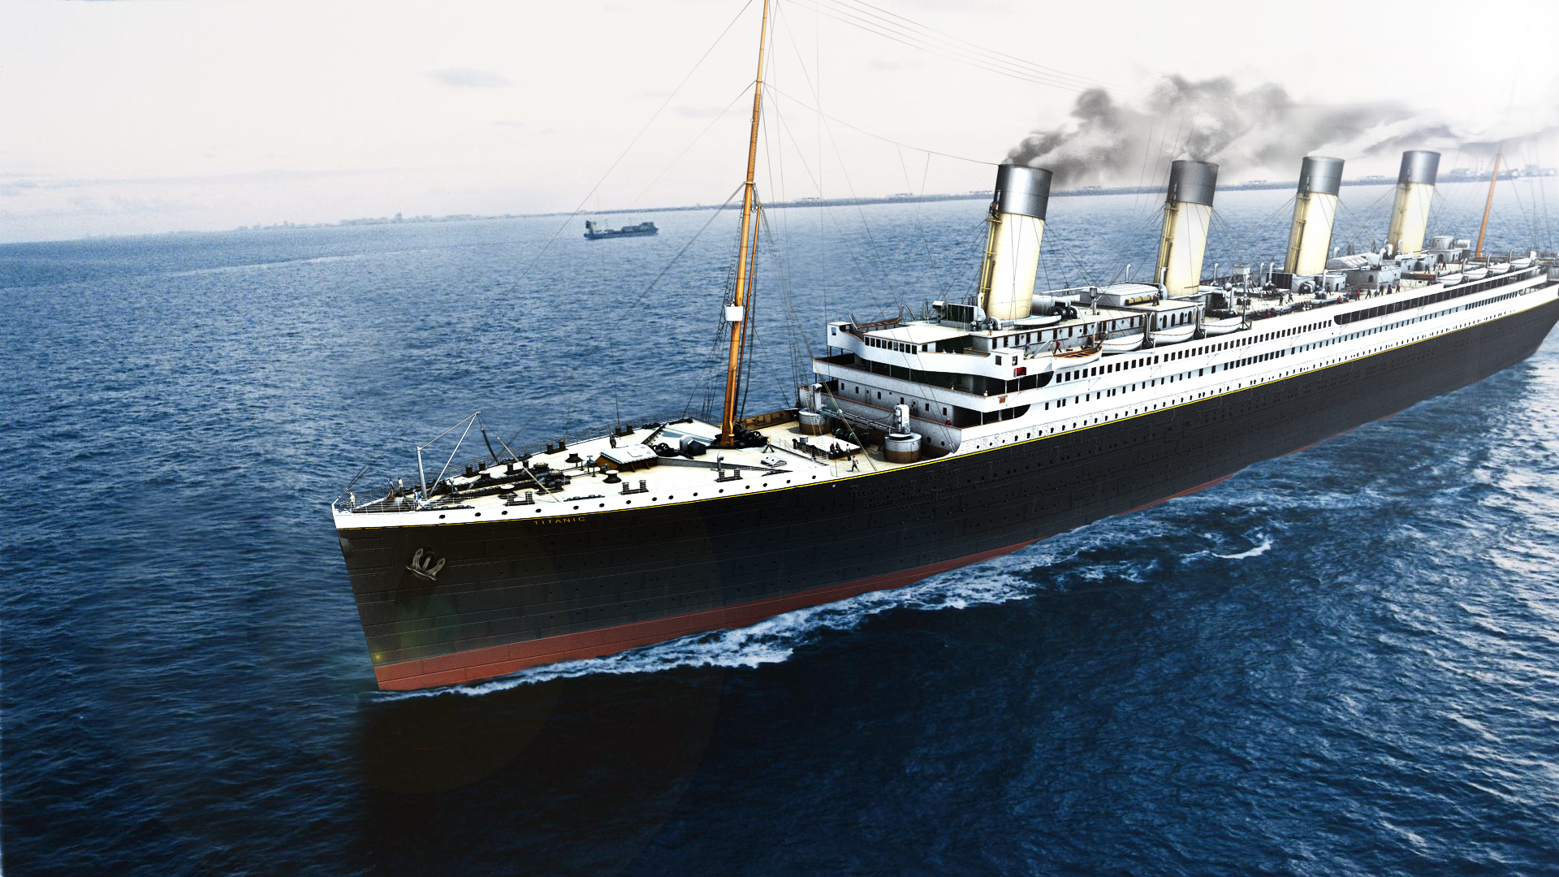
SC1015 Project: Survivor of the Titanic
By FCEC Team 2 SHI QILUN GUO YICHEN TAO QIANKUAN

Slide 2
Problem Definition

Slide 3
To determine the survivors of the Titanic Tragedy

Slide 4


Slide 5
Problem Definition

Slide 6
EDA (Exploratory Data Analysis)

Slide 7
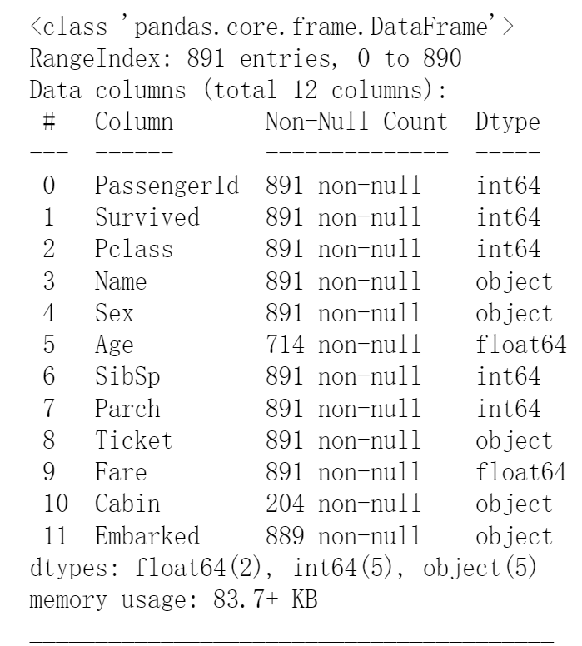
EDA
Which features contain blank, null or empty values?
These will require correcting.
- Cabin > Age > Embarked features contain a number of null values in that order for the training dataset.
- Cabin > Age are incomplete in case of test dataset.
What are the data types for various features?
Helping us during converting goal.
- Seven features are integer or floats. Six in case of test dataset.
- Five features are strings (object).

Slide 8
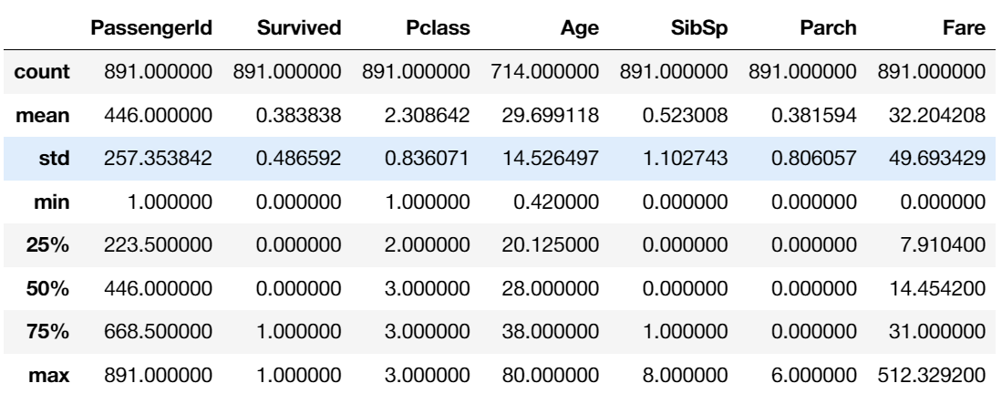
EDA Distribution of numerical features?
- Total samples are 891 or 40% of the actual number of passengers on board the Titanic (2,224).
- Survived is a categorical feature with 0 or 1 values.
- Around 38% samples survived representative of the actual survival rate at 32%.
- Most passengers (> 75%) did not travel with parents or children.
- Nearly 30% of the passengers had siblings and/or spouse aboard.
- Fares varied significantly with few passengers (<1%) paying as high as $512.
- Few elderly passengers (<1%) within age range 65-80.

Slide 9
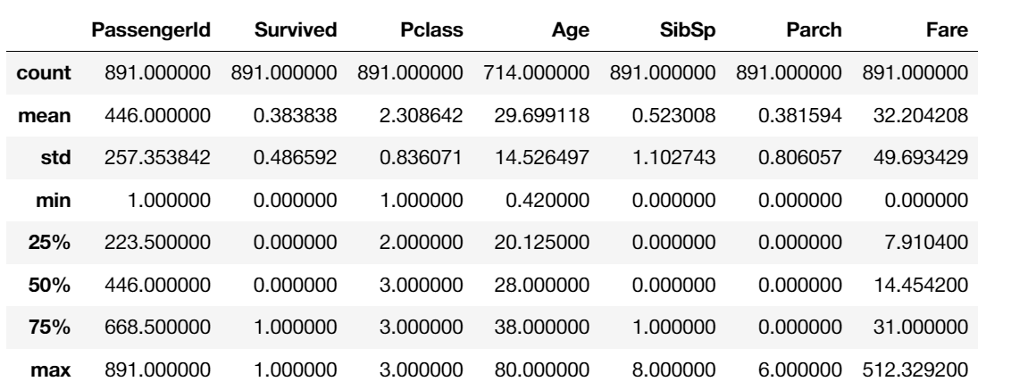
EDA Distribution of categorical features?
Names are unique across the dataset (count=unique=891)
Sex variable as two possible values with 65% male (top=male, freq=577/count=891).
Cabin values have several dupicates across samples. Alternatively several passengers shared a cabin.
Embarked takes three possible values. S port used by most passengers (top=S)
Ticket feature has high ratio (22%) of duplicate values (unique=681).

Slide 10
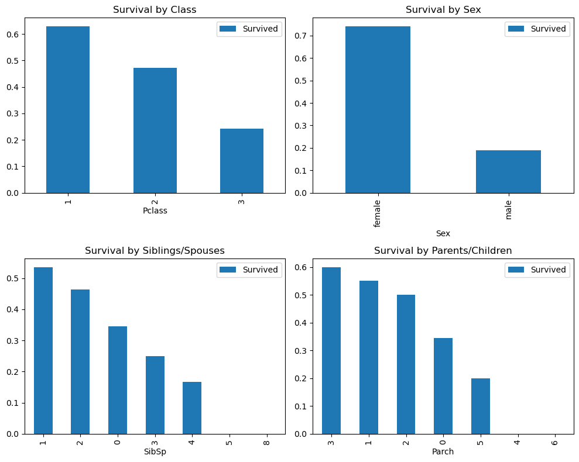
EDA Analyze by pivoting features
Analyze our feature correlations by pivoting features against each other. At this stage can only for features without empty values. Also only for features which are categorical (Sex), ordinal (Pclass) or discrete (SibSp, Parch) type.
Pclass We observe significant correlation (>0.5) among Pclass=1 and Survived (classifying #3). We decide to include this feature in our model.
Sex We confirm the observation during problem definition that Sex=female had very high survival rate at 74% (classifying #1).
SibSp and Parch These features have zero correlation for certain values. It may be best to derive a feature or a set of features from these individual features (creating #1).

Slide 11
EDA

Slide 12
Data Cleaning

Slide 13
Data Cleaning What to do next?
Completing.
We may want to complete Age feature as it is definitely correlated to survival.
We may want to complete the Embarked feature as it may also correlate with survival or another important feature.
Correcting.
Ticket feature may be dropped from our analysis as it contains high ratio of duplicates (22%) and there may not be a correlation between Ticket and survival.
Cabin feature may be dropped as it is highly incomplete or contains many null values both in training and test dataset.
PassengerId may be dropped from training dataset as it does not contribute to survival.
Name feature is relatively non-standard, may not contribute directly to survival, so maybe dropped.
Creating.
We may want to create a new feature called Family based on Parch and SibSp to get total count of family members on board.
We may want to engineer the Name feature to extract Title as a new feature.
We may want to create new feature for Age bands. This turns a continous numerical feature into an ordinal categorical feature.
We may also want to create a Fare range feature if it helps our analysis.

Slide 14
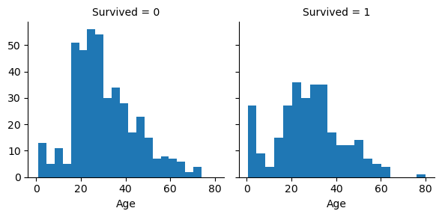
Data Cleaning Correlating numerical features¶
Observations.
Infants (Age <=4) had high survival rate.
Oldest passengers (Age = 80) survived.
Large number of 15-25 year olds did not survive.
Most passengers are in 15-35 age range.
Decisions.
This simple analysis confirms our assumptions as decisions for subsequent workflow stages.
We should consider Age (our assumption classifying #2) in our model training.
Complete the Age feature for null values (completing #1).
We should band age groups (creating #3).

Slide 15
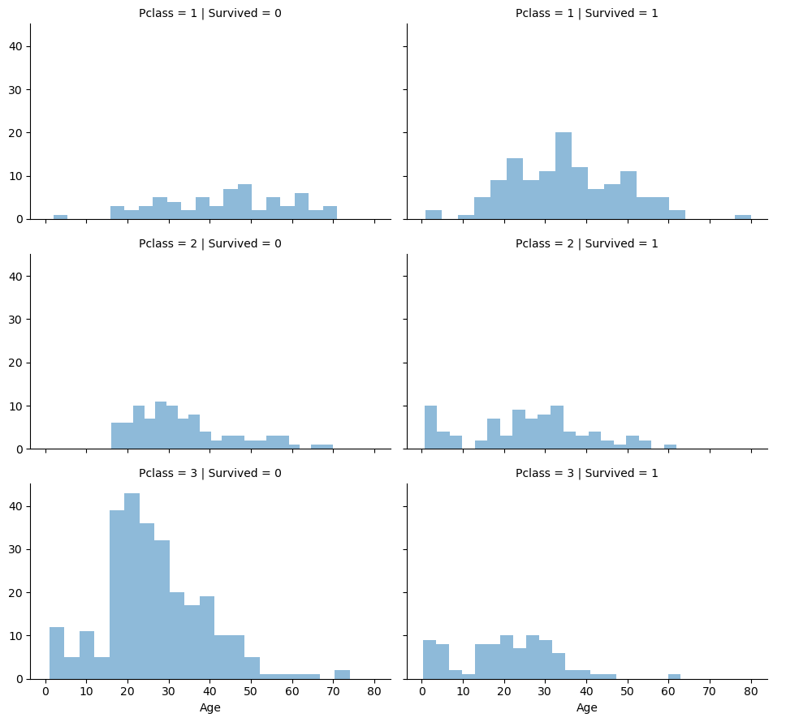
Data Cleaning Correlating numerical and ordinal features
Observations.
Pclass=3 had most passengers, however most did not survive. Confirms our classifying assumption #2.
Infant passengers in Pclass=2 and Pclass=3 mostly survived. Further qualifies our classifying assumption #2.
Most passengers in Pclass=1 survived. Confirms our classifying assumption #3.
Pclass varies in terms of Age distribution of passengers.
Decisions.
Consider Pclass for model training.

Slide 16
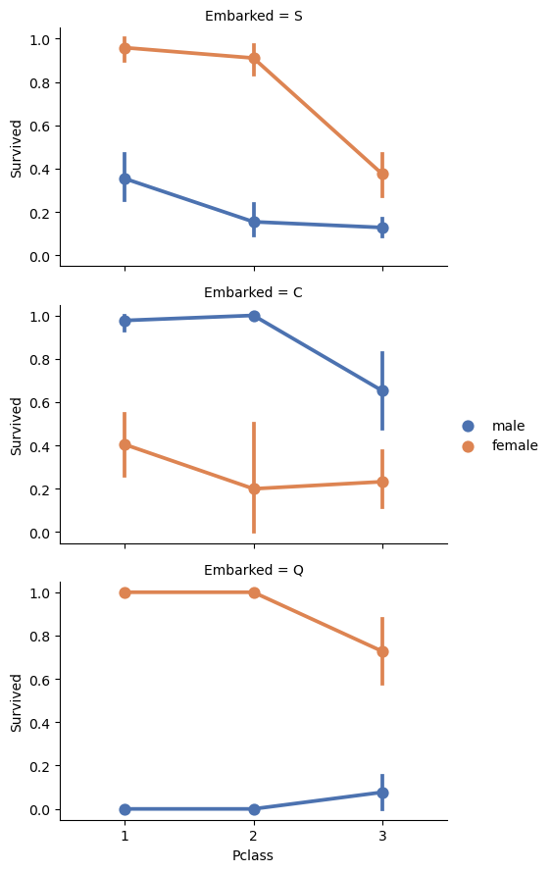
Data Cleaning Correlating categorical features
Observations.
Female passengers had much better survival rate than males. Confirms classifying (#1).
Exception in Embarked=C where males had higher survival rate. This could be a correlation between Pclass and Embarked and in turn Pclass and Survived, not necessarily direct correlation between Embarked and Survived.
Males had better survival rate in Pclass=3 when compared with Pclass=2 for C and Q ports. Completing (#2).
Ports of embarkation have varying survival rates for Pclass=3 and among male passengers. Correlating (#1).
Decisions.
Add Sex feature to model training.
Complete and add Embarked feature to model training.

Slide 17
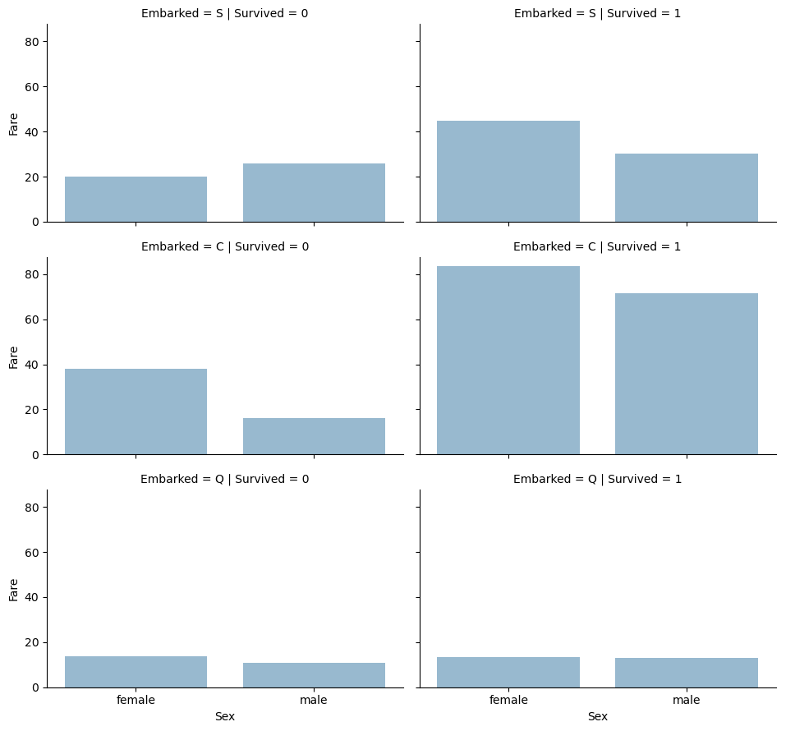
Data Cleaning Correlating categorical and numerical features¶
Observations.
Higher fare paying passengers had better survival. Confirms our assumption for creating (#4) fare ranges.
Port of embarkation correlates with survival rates. Confirms correlating (#1) and completing (#2).
Decisions.
Consider banding Fare feature.

Slide 18
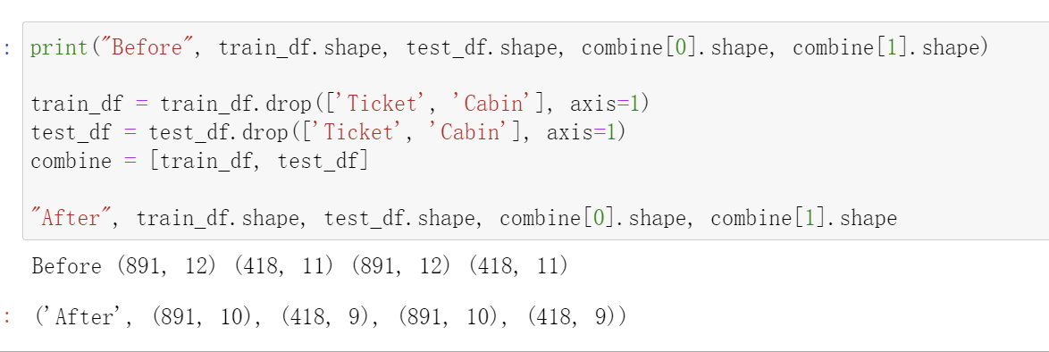
Data Cleaning Correcting by dropping features
Based on our assumptions and decisions we want to drop the Cabin (correcting #2) and Ticket (correcting #1) features.

Slide 19
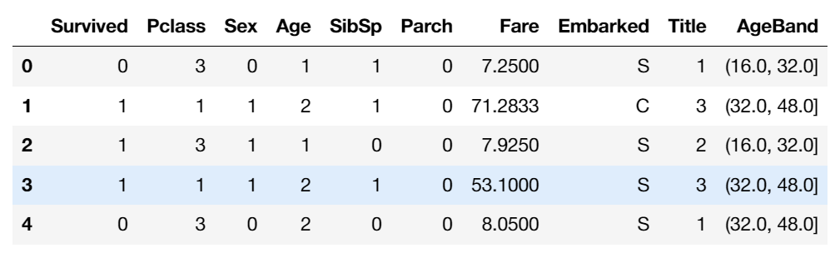
Data Cleaning Completing a numerical continuous feature
Note correlation among Age, Gender, and Pclass. Guess Age values using median values for Age across sets of Pclass and Gender feature combinations:
Preparing an empty array to contain guessed Age values based on Pclass x Gender combinations.
Iterate over Sex (0 or 1) and Pclass (1, 2, 3) to calculate guessed values of Age for the six combinations.
Create Age bands and determine correlations with Survived, and replace Age with ordinals based on these bands.

Slide 20
Data Cleaning Completing a categorical feature
Embarked feature takes S, Q, C values based on port of embarkation. Our training dataset has two missing values. Here we fill these with the most common occurance.
Then convert the EmbarkedFill feature by creating a new numeric Port feature.

Slide 21
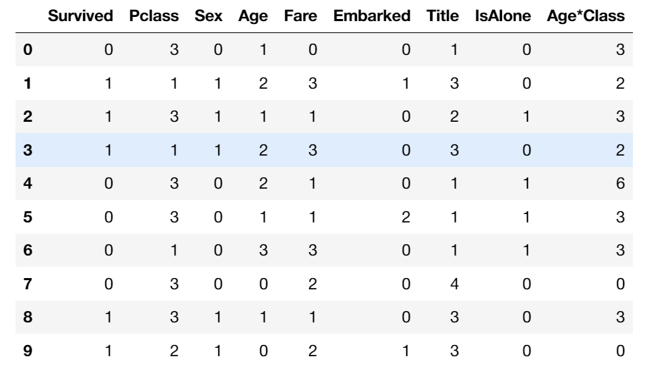
Data Cleaning completing and converting a numeric feature
complete the Fare feature for single missing value in test dataset using mode to get the value that occurs most frequently for this feature
round off the fare to two decimals as it represents currency.
Then create FareBand.
Convert the Fare feature to ordinal values based on the FareBand.

Slide 22
Data Cleaning

Slide 23
Theory and Algorithms

Slide 24
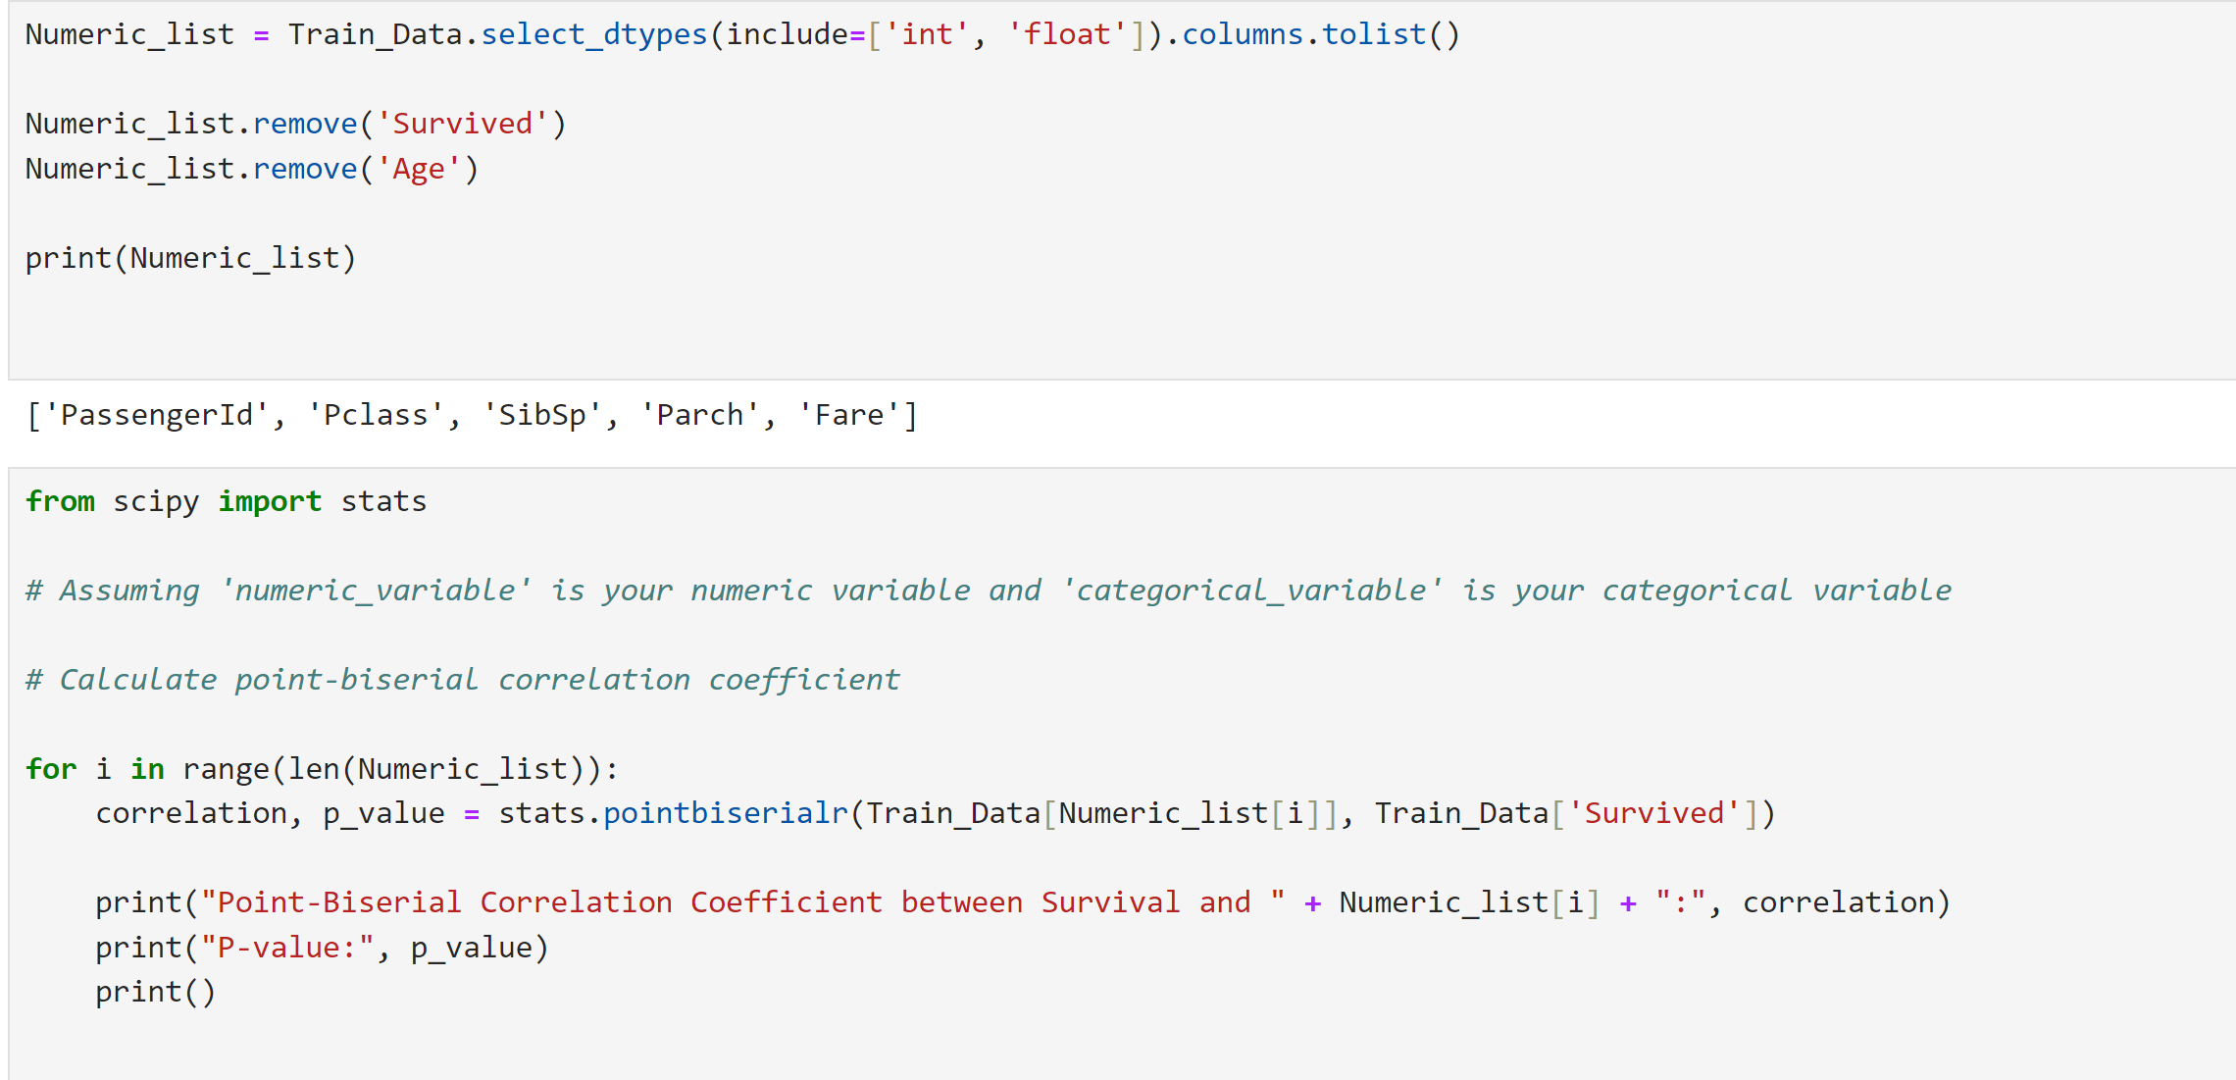
Initial Attempt

Slide 25
Initial Attempt
Removal of the “Survived” column since it’s the response variable
Removal of the “Age” column due to missing values.

Slide 26
Initial Attempt (dataset cleaning)
Determine correlation and p-value to determine the significance
Point-biserial correlation used to handle categorical variables
Variable Name | Correlation with “Survived”
PassengerId | -0.00501
Pclass | -0.338
SibSp | -0.0353
Parch | 0.0816
Fare | 0.257

Slide 27
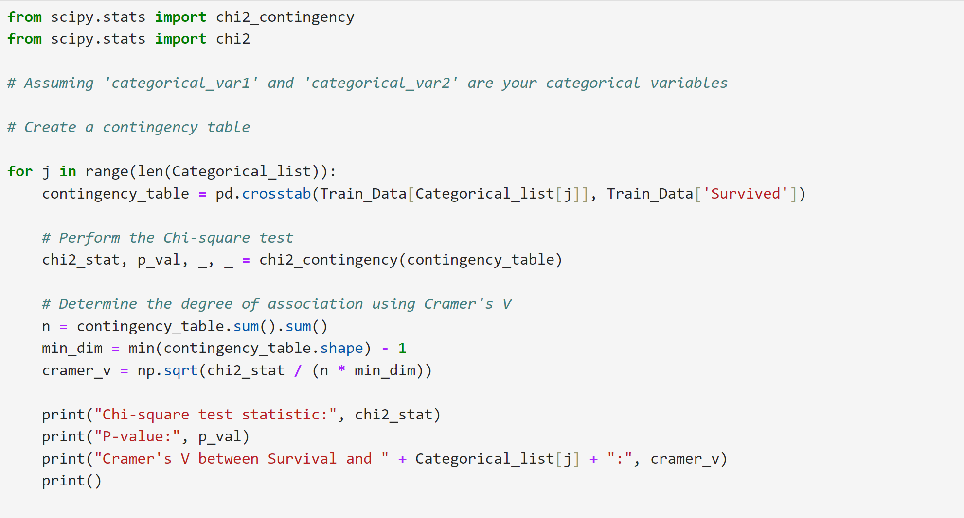
Initial Attempt (dataset cleaning)
Now do the same for categorical variables
“Name” and “Ticket” has the highest correlations

Slide 28
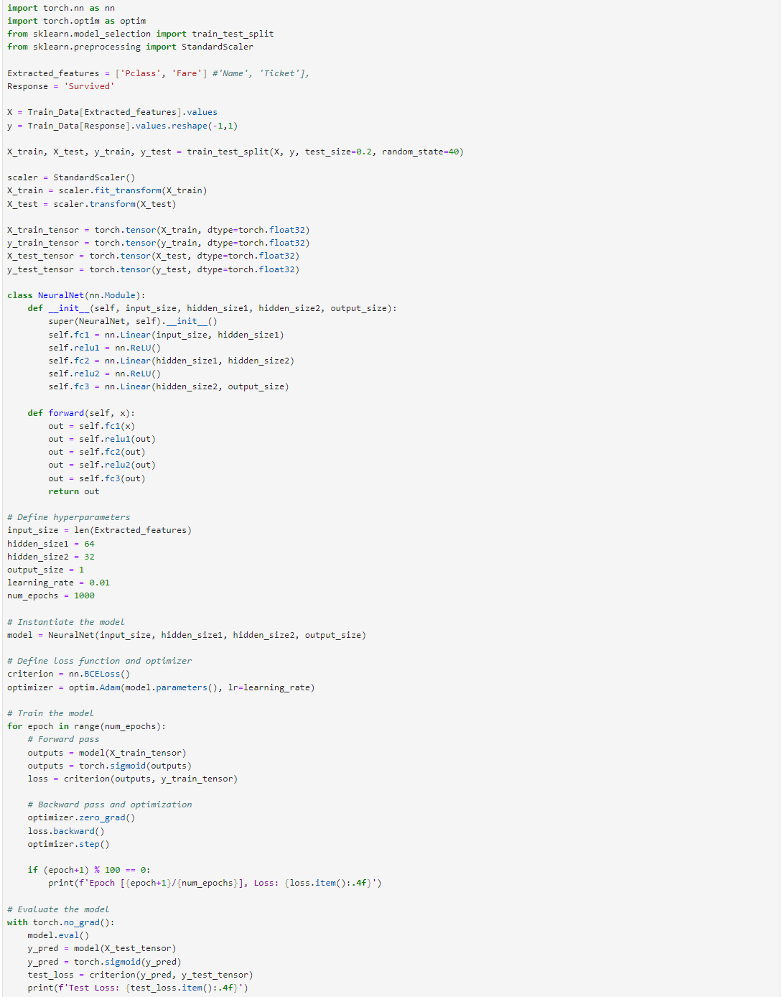
Initial Attempt: Neural Network Learning
Full Algorithm

Slide 29
Initial Attempt: Neural Network Learning
2 more variables dropped due to missing values/mix of string and float
Train test split here

Slide 30
Initial Attempt: Neural Network Learning
Constructing the NN layers

Slide 31
Initial Attempt: Neural Network Learning
Creating ReLU layers

Slide 32
Initial Attempt: Neural Network Learning
Using BCELoss (Binary Cross Entropy) function to assess performance
Using Sigmoid function to keep output between 0 and 1 (as defined in the dataset)
Backward passing

Slide 33
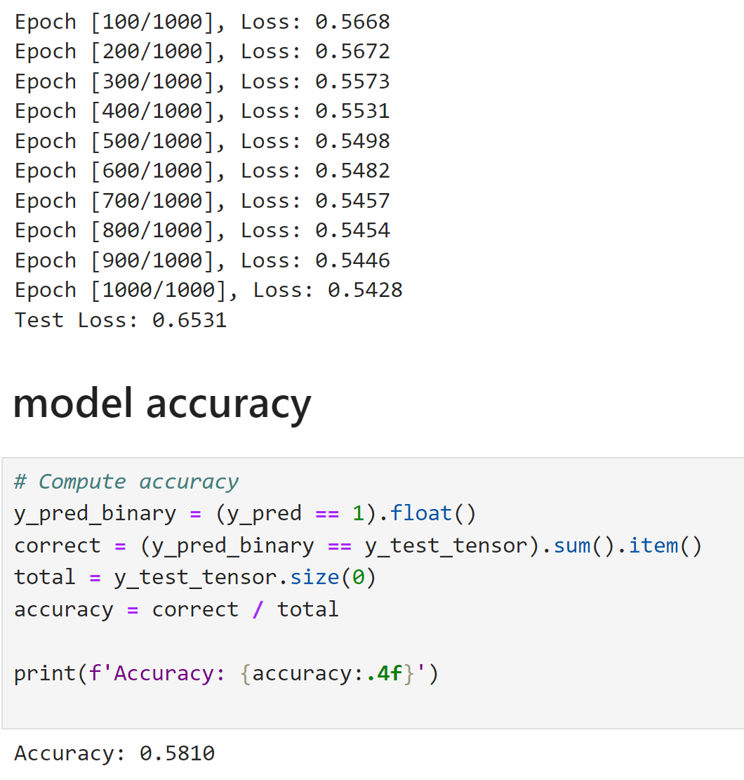
Result (Rather Abysmal)

Slide 34
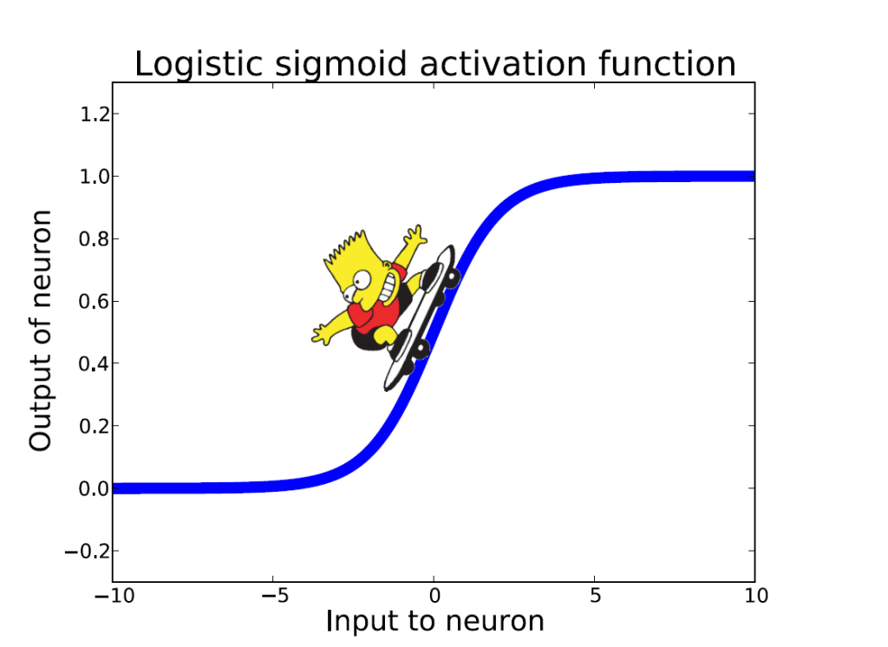
Improvised Solutions: Logistic Regression
use Logistic Regression to validate assumptions and decisions for feature creating and completing goals.
done by calculating the coefficient of the features in the decision function.
Positive coefficients increase the log-odds of the response (and thus increase the probability), and negative coefficients decrease the log-odds of the response (and thus decrease the probability).

Slide 35
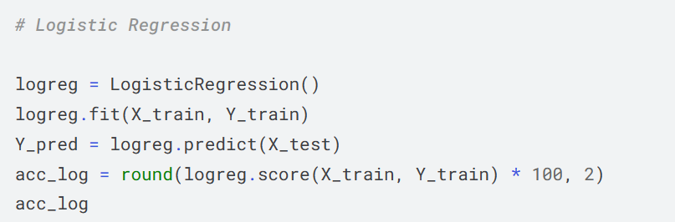
“Sex” variable is highest positive coefficient, implying as the Sex value increases (male: 0 to female: 1), the probability of Survived=1 increases the most.
Inversely as Pclass increases, probability of Survived=1 decreases the most.
Age*Class is a good artificial feature to model as it has second highest negative correlation with Survived.
Title as second highest positive correlation.
The overall accuracy is 80.36

Slide 36


Solutions: Decision Tree
This model uses a decision tree as a predictive model which maps features (tree branches) to conclusions about the target value (tree leaves).
Tree models where the target variable can take a finite set of values are called classification trees; in these tree structures, leaves represent class labels and branches represent conjunctions of features that lead to those class labels.
Decision trees where the target variable can take continuous values (typically real numbers) are called regression trees.

Slide 37
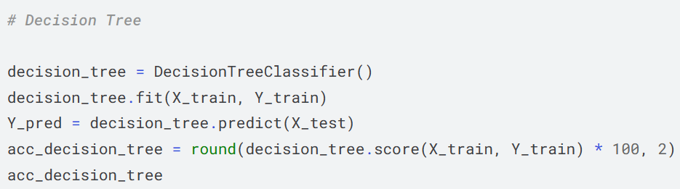
The model confidence score is the highest among models evaluated so far.
The accuracy is 86.76

Slide 38

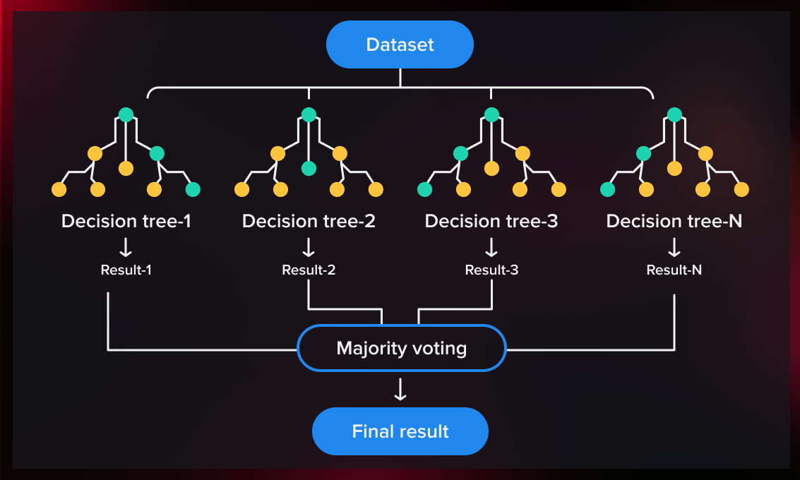
Best Solution: Random Forest
Random forests or random decision forests are an ensemble learning method for classification, regression and other tasks
operate by constructing a multitude of decision trees (n_estimators=100) at training time
outputting the class that is the mode of the classes (classification) or mean prediction (regression) of the individual trees.

Slide 39
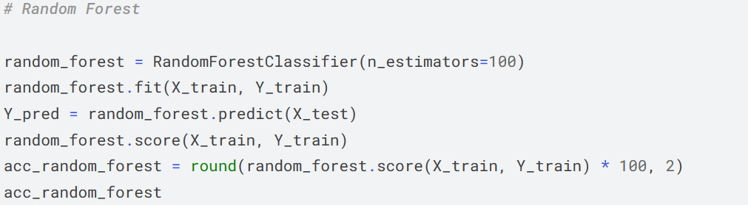
Best Solution: Random Forest
The model confidence score is the highest among models evaluated so far.
We decide to use this model's output (Y_pred) for creating our competition submission of results.
The accuracy is 86.76 as well.

Slide 40
Theory and Algorithms

Slide 41
Data-Driven Insights

Slide 42
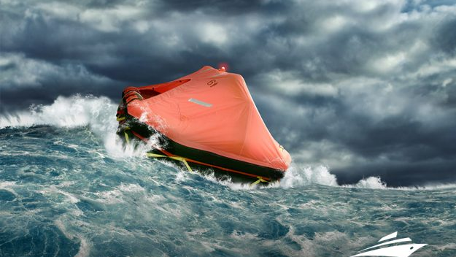
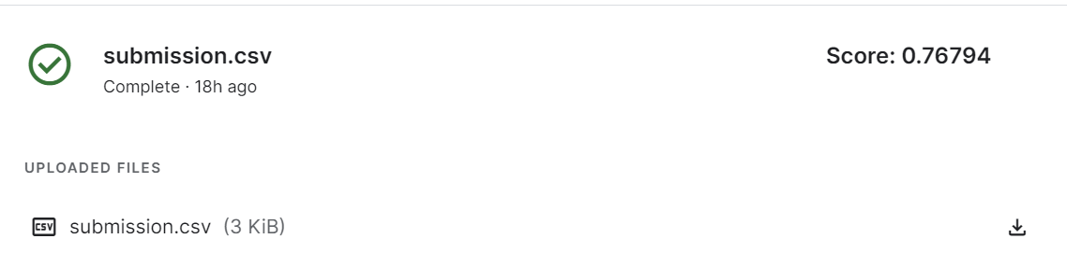
Insights
Random Forest classifier produces the best accuracy of 86.76%, and when implemented to actual prediction(unlabeled data for prediction), we achieved an overall score of 76.8 on kaggle
Our attempts may offer further suggestions on improving surviving rates for sea disasters

Slide 43

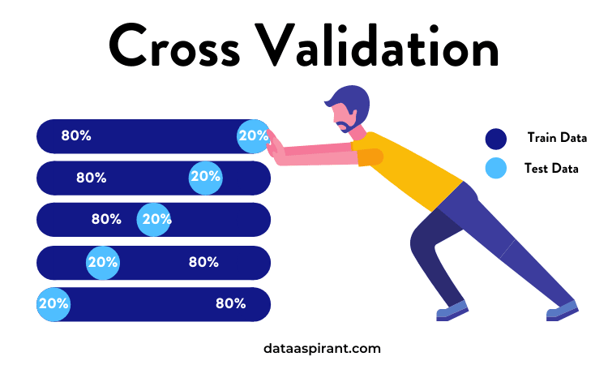
Further to Improve
Usage of TensorFlow Decision Forests to train a baseline Gradient Boosted Trees Model
Implement stacking of different models to refine predictions based on the strengths of individual models.
Use more robust cross-validation techniques like StratifiedKFold or TimeSeriesSplit to ensure the model's performance is consistent across different subsets of data.

Slide 44
Data-Driven Insights

Slide 45

THANK YOU

Slide 46

Titanic Wallpaper image. (2021, January 1). ModDB. https://www.moddb.com/mods/mafia-titanic-mod/images/titanic-wallpaper Titanic - Machine Learning from Disaster | Kaggle. (1912, April 14). Retrieved April 24, 2024, from https://www.kaggle.com/competitions/titanic
References

